Slide 1

Data Analytics Report for the Titanic Dataset
Explore the story of the Titanic in a comprehensive data analysis project. Discover key insights into factors that influenced passenger survival and the importance of data-driven decision-making.
JR
© Kardashev Alliance 2023

Slide 2
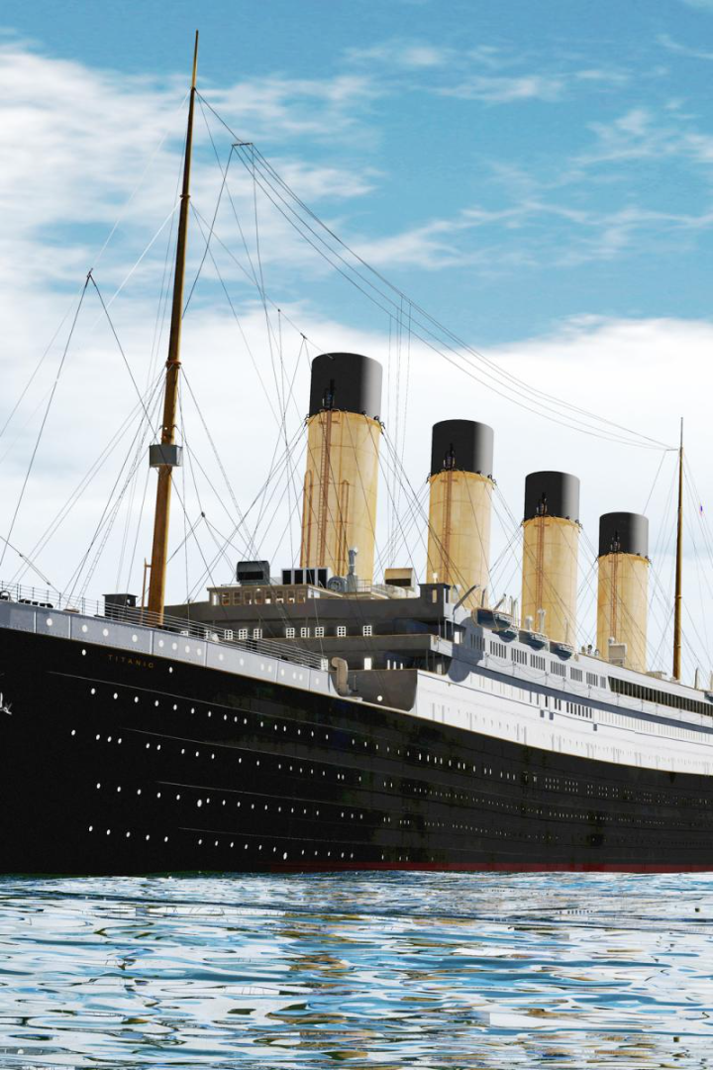
Titanic Survival Analysis
The Titanic was a legendary passenger ship that tragically sank on its maiden voyage. Our dataset aims to shed light on the factors that influenced passengers' survival on this historic voyage, providing valuable insights into a critical event in maritime history.

Slide 3

Identifying the Data Problem
How did passenger class impact survival rates?
What role did age play in determining survival?
Did gender significantly influence the chances of survival?
To what extent did the fare paid affect the likelihood of survival?

Slide 4
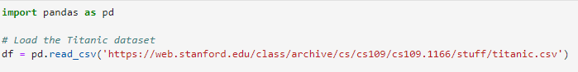
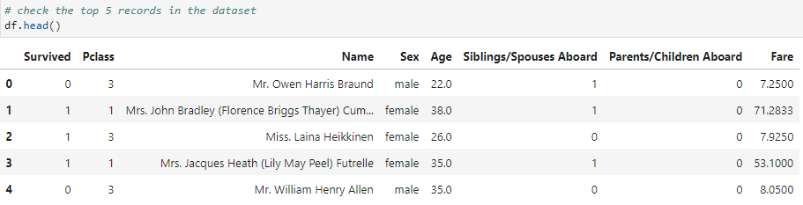
Data Collection and Overview
Source of the Dataset
We’re using Stanford’s CS109 Titanic dataset.
Key Variables in the Dataset
As defined in the Jupyter Notebook, there are a series of variables analyzed within the dataset. The variables are: Survived, Pclass, Name, Sex, Age, Siblings/Spouses Aboard, Parents/Children Aboard, Fare.

Slide 5



Data Cleaning Process
Handling Missing Values
Addressing Outliers
Ensuring Data Consistency
Handling missing values in data science is crucial as it can lead to biased results and incorrect conclusions, impacting the overall quality and validity of the analysis.
Outliers can significantly skew statistical analyses and machine learning models, leading to inaccurate insights and predictions.
We need to maintain accuracy and reliability, preventing erroneous conclusions and decisions on inconsistent and unreliable data.

Slide 6
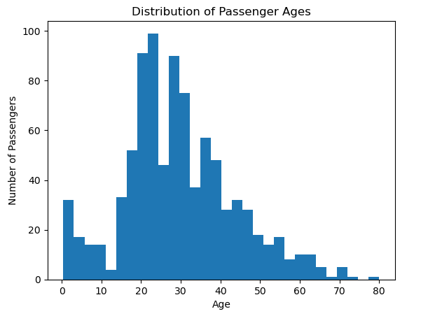
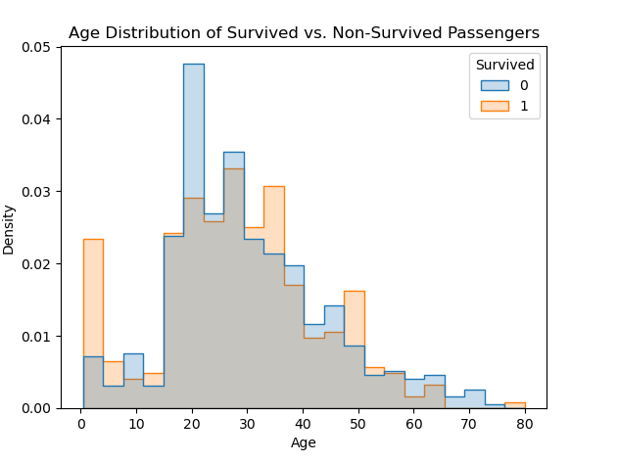
Distribution of Passenger Ages

Slide 7
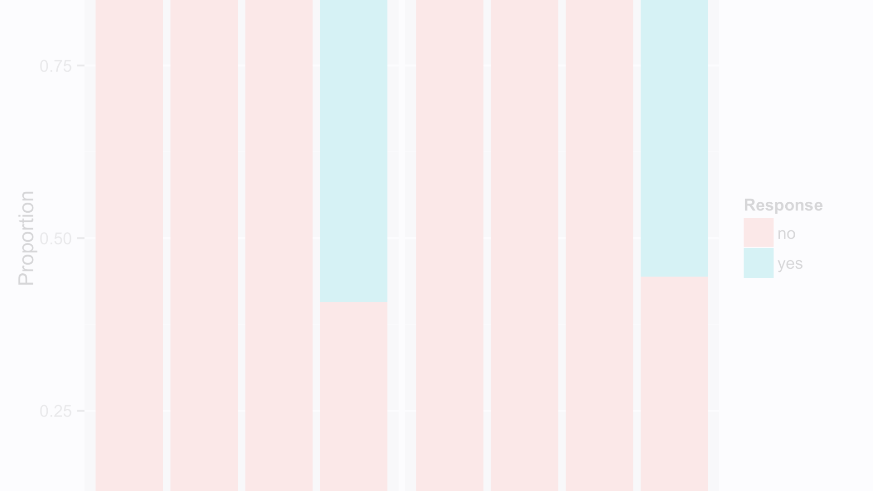
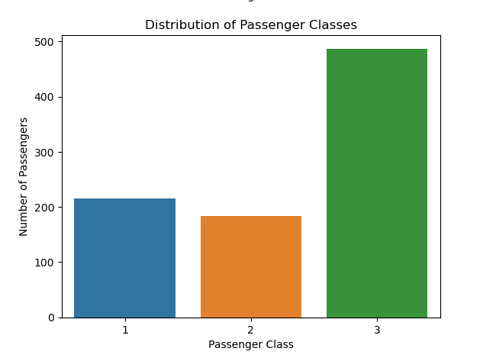
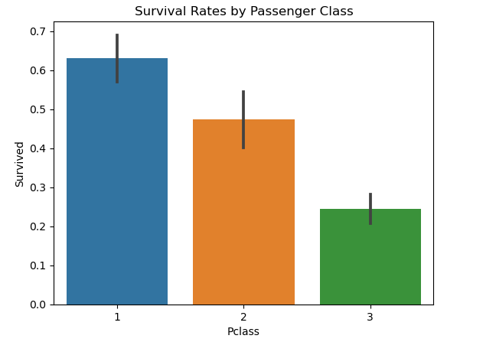
Survival Rates by
Passenger Class

Slide 8
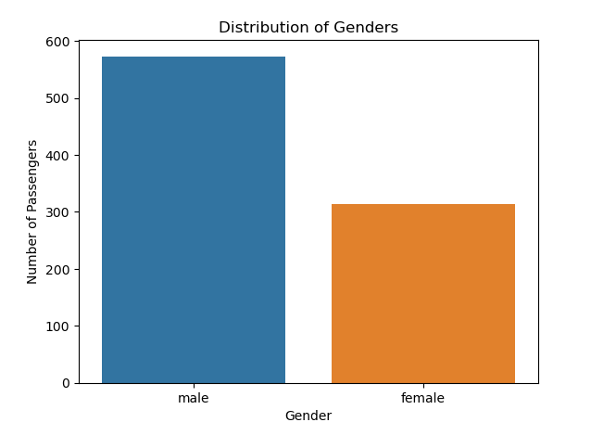
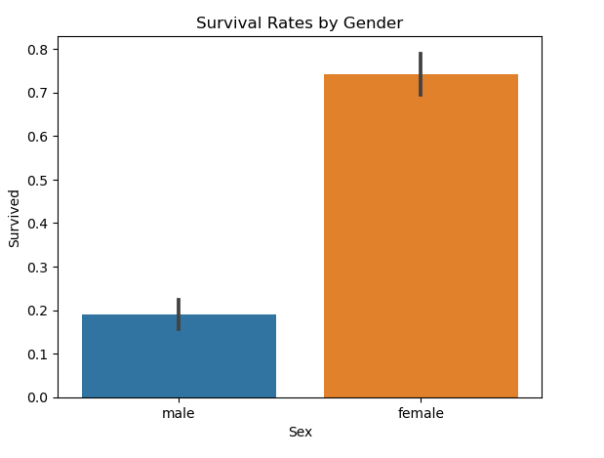
Survival Rates by Gender

Slide 9


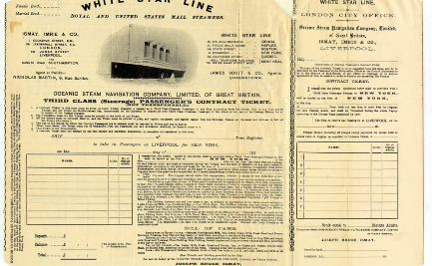
Key Data-Driven Insights
First-class Passengers had Higher Survival Rates
Age and Gender Played Significant Roles
Fare Correlation with Survival

Slide 10

Concluding Remarks
In conclusion, our analysis of the Titanic dataset has shed light on the key factors influencing survival, including passenger class, age, gender, and fare. These insights not only enhance our understanding of this historic tragedy but also serve as a valuable lesson in data-driven decision-making. As we navigate the sea of data in our own endeavors, let us remember the importance of rigorous analysis and thoughtful interpretation to make informed choices and improve outcomes.

